Slide 1
Relational Database Design
Date of Presentation: 6/9/2023

Slide 2
Lesson 3: Extended ER Model/Diagam
Gerald Balekaki

Slide 3
Outline
Introduction
Extended-ERD features
Subtype and supertype
Specialization and generalization
Overlapping and disjoint constraints
Completeness constraints (total and partial)
E-ERD design example
Relation Schemas from E-ERDs

Slide 4
Introduction
Extended-ERM/ERD
Is also known as enhanced version of traditional ERM/ERD
It extends the capabilities of ER modeling by introducing additional components.
E-ERD features represent complex relationships and constraints more effectively.
E-ERD features
Subtype and supertype entities
Generalization and specialization
Overlapping and disjoint constraints
Completeness constraints (total/partial)

Slide 5
Entity Subtype and Supertype
Both entities are used in modeling hierarchical relationships between entities
Supertype entity
also known as high-level entity represents a general entity
has common characteristics to all low-level entities (subtypes)
Subtype entity
also a low-level entity represents a specialized entity.
it inherit attributes and relationships from the supertype.
has unique characteristics specific to each subtype.
the hierarchical relationship between these entities is known as:
“ISA” Relationship

Slide 6
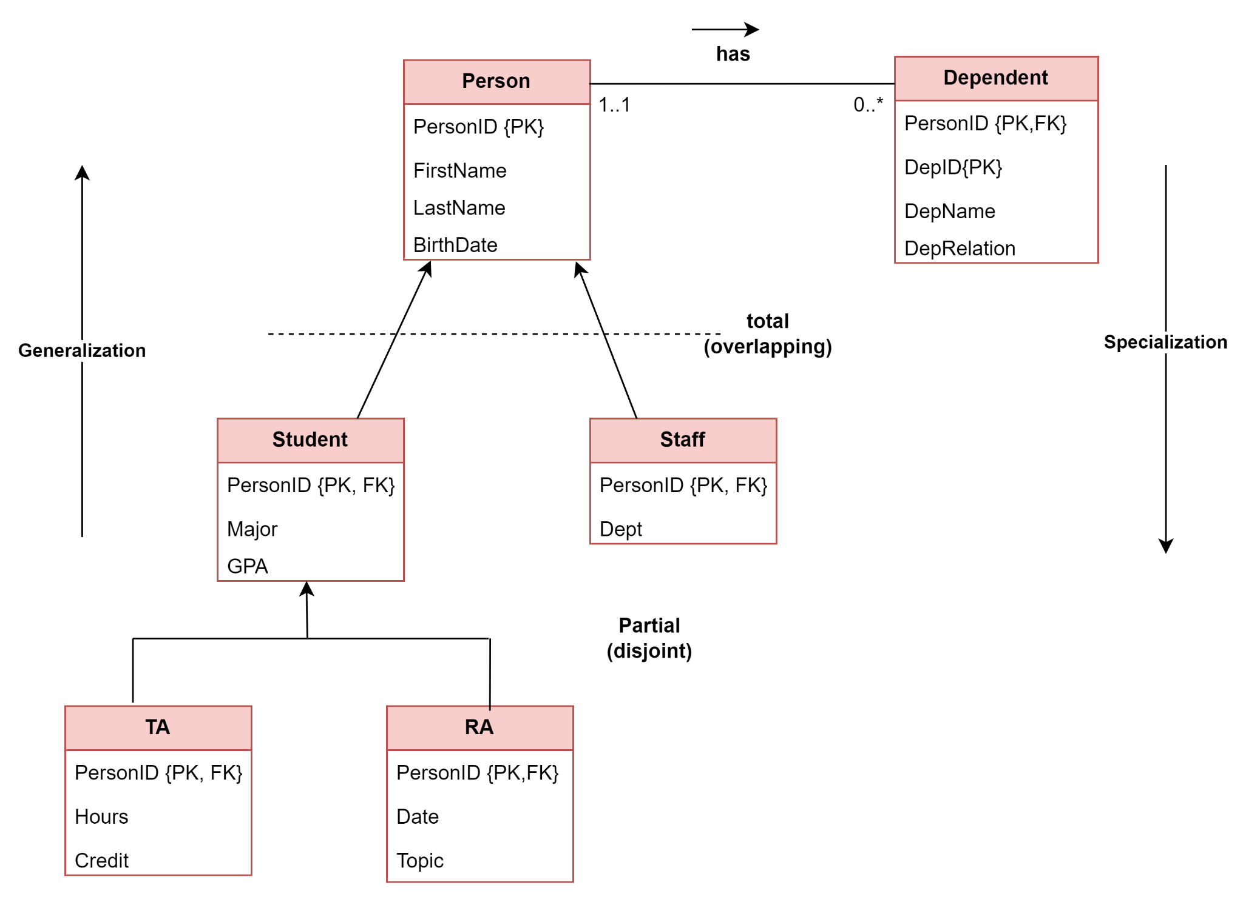
Basic Extended-ERD
Supertype
(Person)
Subtypes
(Student, Staff, TA, RA)
every subtype has only one supertype (Person)
Inherited relationship
association between Person and dependent
Inherited attributes
PersonID, FirstName, LastName, and BirthDate
Weak entity
Dependent (PK: PersonID + DepID)
ISA
ISA

Slide 7
Specialization and Generalization
Specialization
top-down design process
is based on grouping unique characteristics and relationships of subtypes
relates to more specific subtypes from supertypes
Generalization
bottom up design process
is based on grouping common characteristics and relationships of subtypes
relates to more generic supertypes from subtypes
ISA
ISA

Slide 8
Overlapping and disjoint constraints
Overlapping subtypes
indicated by separate arrows from subtypes
each subtype contains common subsets of supertype
implies that an instance of a supertype appears at least one subtype.
(A person can be both student and Staff)
Disjoint (non overlapping) subtypes
indicated by merged arrows from subtypes
each subtypes is a unique subset of a supertype
implies that an instance of supertype appears only in one subtype
(A student is either a TA or RA, but not both)
ISA
ISA

Slide 9
Completeness (total/partial) constraints
Completeness constraints
this specifies whether a supertype occurrence must be a member of at least one subtype.
Total
indicated by dotted line across the arrows from subtypes
every supertype occurrence must be a member of at least one subtype
(Person: 1: Peter; 2: John) – both Persons must be in the subtypes
Partial [default]
it is the default one [no dotted line]
some supertype occurrences need not to be members of any subtype.
(Person: 1: Peter; 2: John) – either Persons don’t need to be in the subtypes.
ISA
ISA

Slide 10
Relation schemas in E-ERDs
Supertype
Person (PersonID, FirstName, LastName, BirthDate)
Subtypes
Student (PersonID, FirstName, LastName, BirthDate, Major,GPA)
Staff (PersonID, FirstName, LastName, BirthDate, Dept)
TA (PersonID, FirstName, LastName, BirthDate, Hours,Credit)
RA (PersonID, FirstName, LastName, BirthDate, Date,Topic)
Weak entity
Dependent (PersonID, DepID, DepName, DepRelation)
ISA
ISA

Slide 11
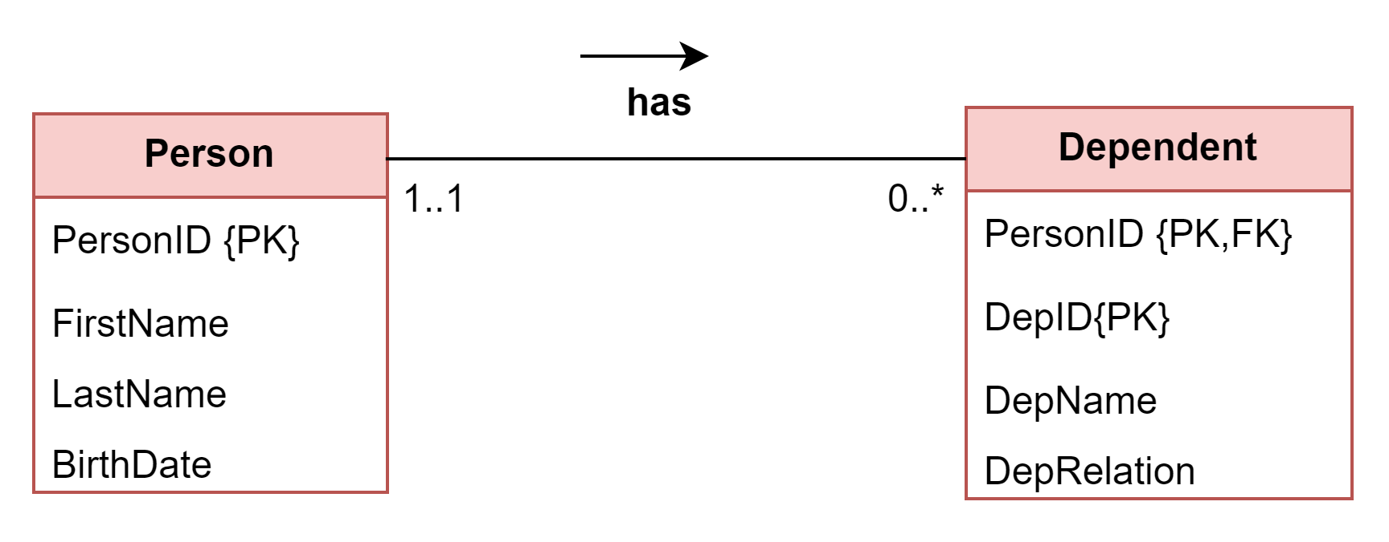
Weak and Strong entity
Weak entity
cannot be uniquely identified by its own attributes alone.
it depends on the existence of a related entity (owner entity/strong entity)
Existence-dependent
PK is partially/totally derived from parent entity.
PK: (PersonID+DepID)
Strong entity
can be uniquely identified by its own attributes without depending on any other entities.
Existence-independent
Dependent (PersonID, DepID, DepName, DepRelation)

Slide 12
Weak and Strong relationships
Weak (non-identifying)
Is a relationship when a primary key (PK) of a related (Child) entity does not contains a PK component of a parent entity.
if PK in Dependent “NOT INCLUDE” PersonID
Strong (identifying)
Is a relationship when a PK of the related(Child) entity contains a PK component of a parent entity.
if PK in Dependent “INCLUDE”PersonID
Dependent (PersonID, DepID, DepName, DepRelation)

Slide 13
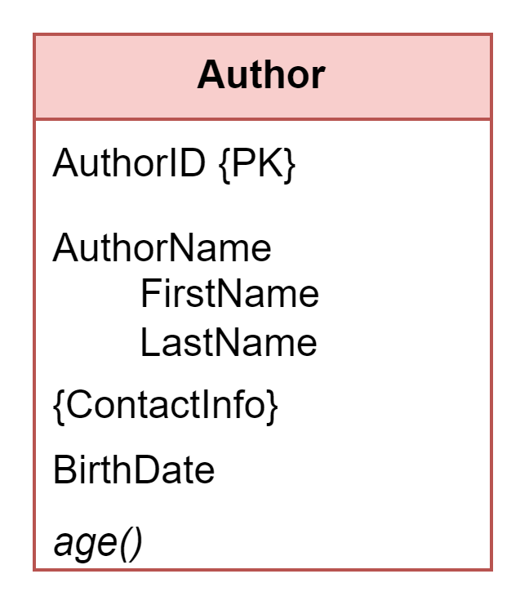
Representing composite attributes in relation schema
Composite attribute[AuthorName]
each of its components become a separate single-valued attribute.
Example:
FirstName → AuthorName_FirstName
LastName → AuthorName_LastName
Relation schema
Author (AuthorID, AuthorName_FirstName, AuthorName_LastName, BirthDate)
Age()
is derived attribute – should not be included in the relation schema.
{ContactInfo} is multi-valued attribute
(see next slide)

Slide 14
Representing Multi-valued attributes (MVA) in relation schema
Approach: to combine the PK of the entity containing a MVA and MVA itself to form a new relation (also PK).
PK of entity containing MVA – > AuthorID
Multi-valued attribute – > ContactInfo
Name a new relation without MVA – > entity_Name and MVA
PK in new relation – > entity_PK + MVA
Author_ContactInfo (AuthorID, ContactInfo)
if AuthorID 111 enters two ContactInfo [234, 345]
tuple 1: [111: 234]
tuple 2: [111: 345]
Relation schemas to store Author information:
Author (AuthorID, AuthorName_FirstName, AuthorName_LastName, BirthDate)
Author_ContactInfo (AuthorID, ContactInfo)

Slide 15
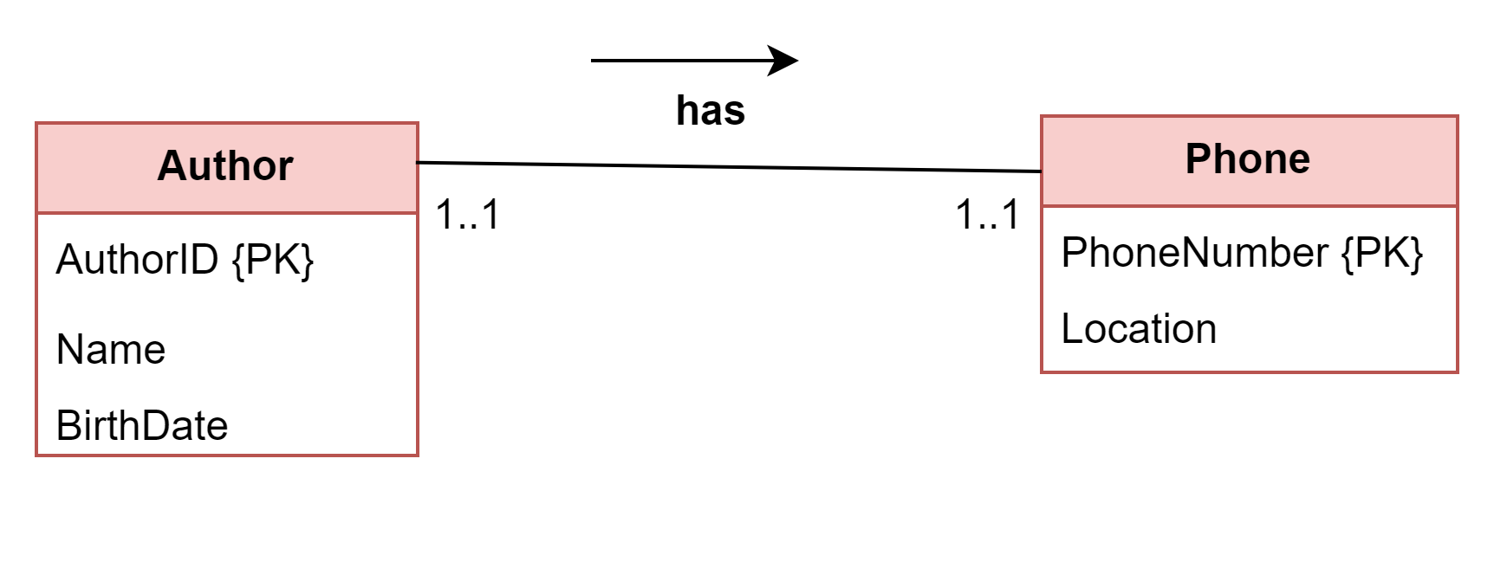
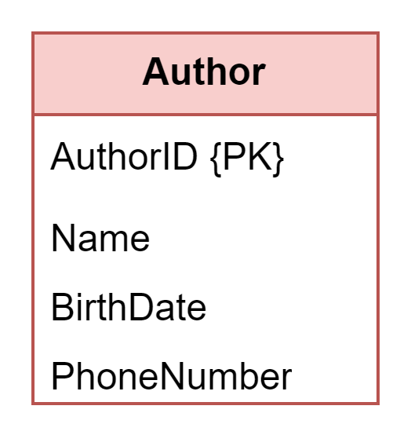
E-R Design issues
Use of entity sets vs attributes
the decision depends on the structure of enterprise being modeled.
case I:
if organization wants to collect only one phone number
case II:
wants to collect more info on phone, e.g., typeOfPhone, service_company.
case III:
wants to collect more than one phone number.
VS

Slide 16
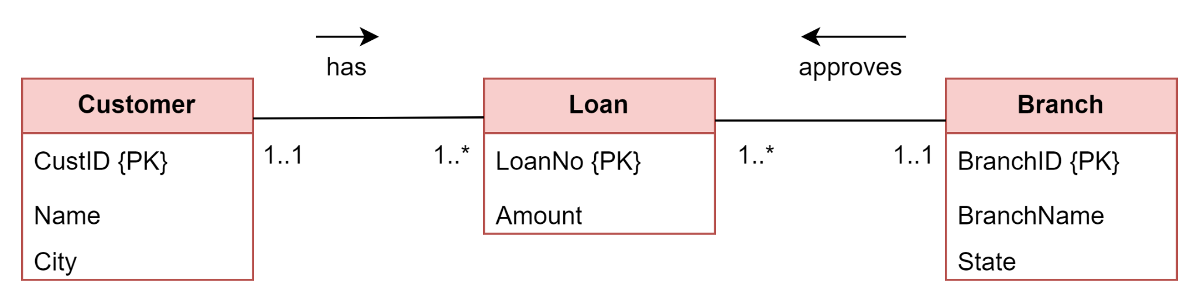
E-R Design issues …cont’d
Use of entity sets vs relationships sets
want to decide whether objects in a relationship are entities or relationship.
Example:
customer has loan of a particular amount in a branch.
loan in this relationship is an entity with loanNumber and amount as attributes
Approach: create a loan as an entity

Slide 17
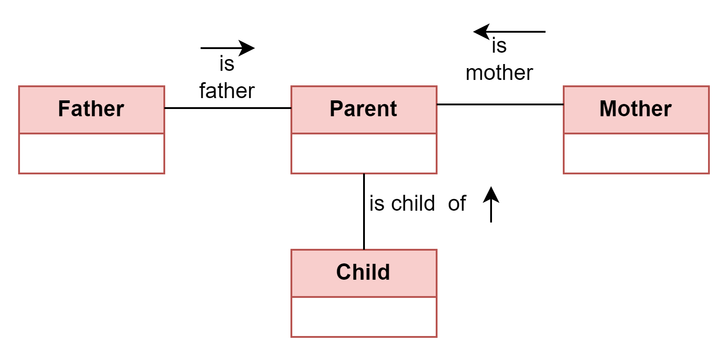
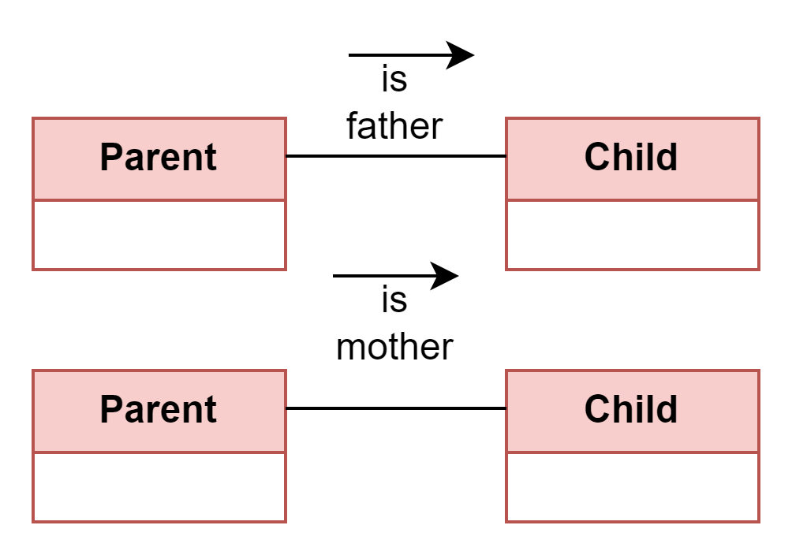
E-R Design issues …cont’d
Binary vs n-ary relationships
preferable to replace non-binary relationships with distinct binary relationships.
Note –
there are relationships that are naturally non-binary

Slide 18
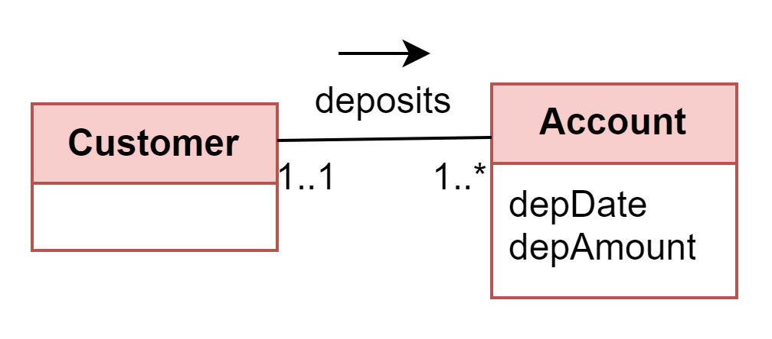
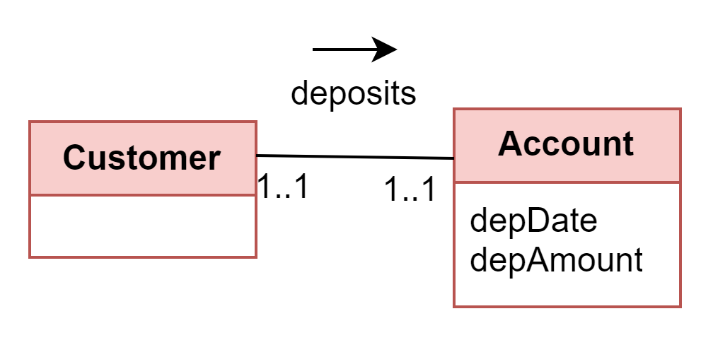
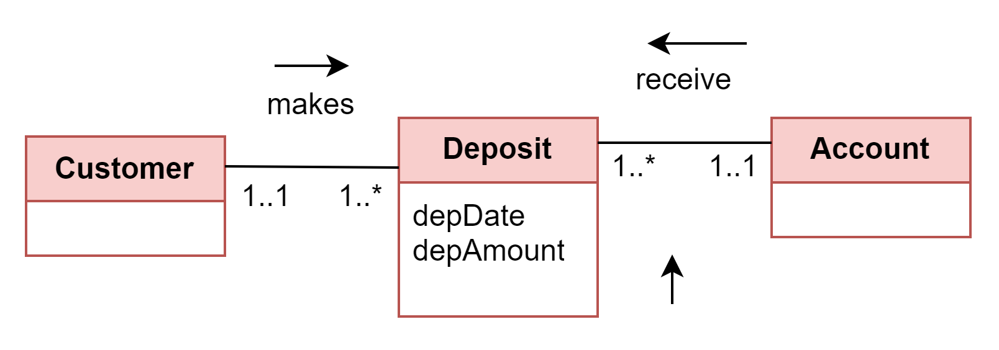
E-R Design issues …cont’d
Placement of relationship attributes
Attributes of 1:M relationship
can be moved to the many side of the relationship
Attributes of a 1:1 relationship
can be placed on either sides.
Attributes of a M:M relationship
to be included in the bridge entity
Example:
A customer makes deposits to an account. Each deposit records date and amount.

Slide 19
Activities
Find enrichment activities on extended ERDs in the assessment section
Attempt activities 3.1 and 3.2

Slide 20
Summary
Introduction
Extended-ERD features
Subtype and supertype
Specialization and generalization
Overlapping and disjoint constraints
Completeness constraints (total and partial)
E-ERD design example
Relation Schema from E-ERDs
🡺NEXT
Functional dependency

